Slide 1
Personal Finance Project
Catherine Lu

Slide 2

CAREER
Occupation: Startup Investment Analyst
Responsibility:
Provide stockbrokers, fund managers and stock market traders with financial information, advice and recommendations
Evaluate companies by analyzing the company’s accounts, profit and loss sheets, cash flow, and other relational databases
Interpret financial transactions
Write financial research summaries
Obtain updated knowledge about the general economy and financial markets
Qualifications and Training Required:
A degree related to business
MBA
Relevant paid or voluntary experiences or internships
Language skills
Salary: $40,000 per month

Slide 3

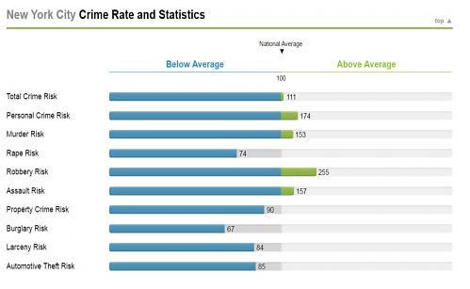
LOCATION
State and City: Manhattan, New York City
Community information
Total area: 33.6 sq mi
Total population: 16,571,571
Male population: 7,878,742 (47.5%)
Female population: 8,692,771 (52.5%)
White collar: 15,105 (62.3%)
Blue collar: 9,145 (37.7%)
Crime rate: 11% above national average

Slide 4
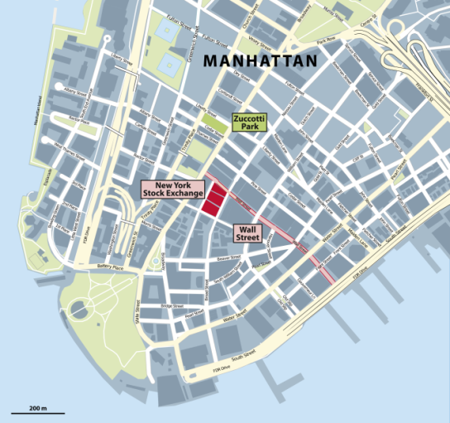
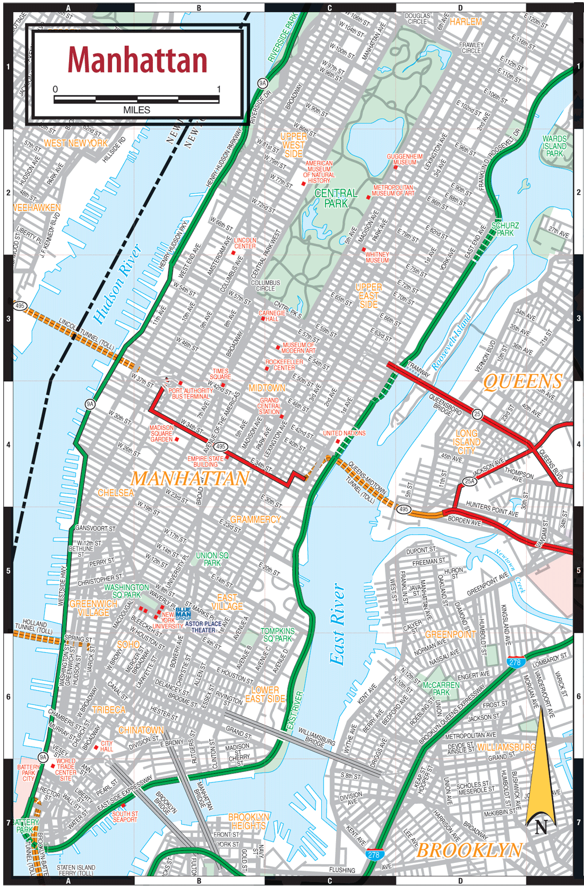
LOCATION
Possible places of employment: Morgan Stanley, JPMorgan Chase, Bear Stearns, Goldman Sachs, Merrill Lynch, Citigroup, UBS, HSBC, Wells Fargo, RBC Capital Markets

Slide 5

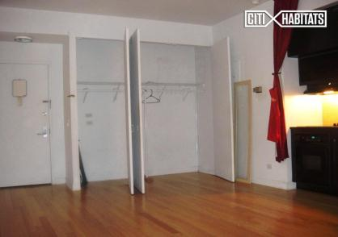
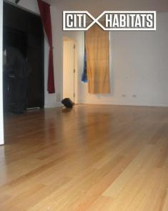
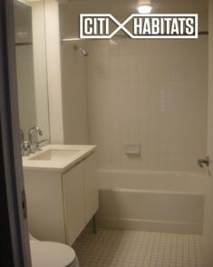
HOUSING
Address: 56 Pine St APT 6E, New York, NY 10005
Type of housing: Studio
Floor size: 430 sq ft
Height: 10 ft ceilings
Amenities: kitchen, large closet, central AC / heating, 24-hour doorman and concierge service, washer and dryer, fitness center, WIFI meeting room, lounge, bicycle storage, media room and party room
Rent per month: $2200 /month
Utility cost: $1.81 + $24.53 + $16.16 + $20.11 = $62.61

Slide 6
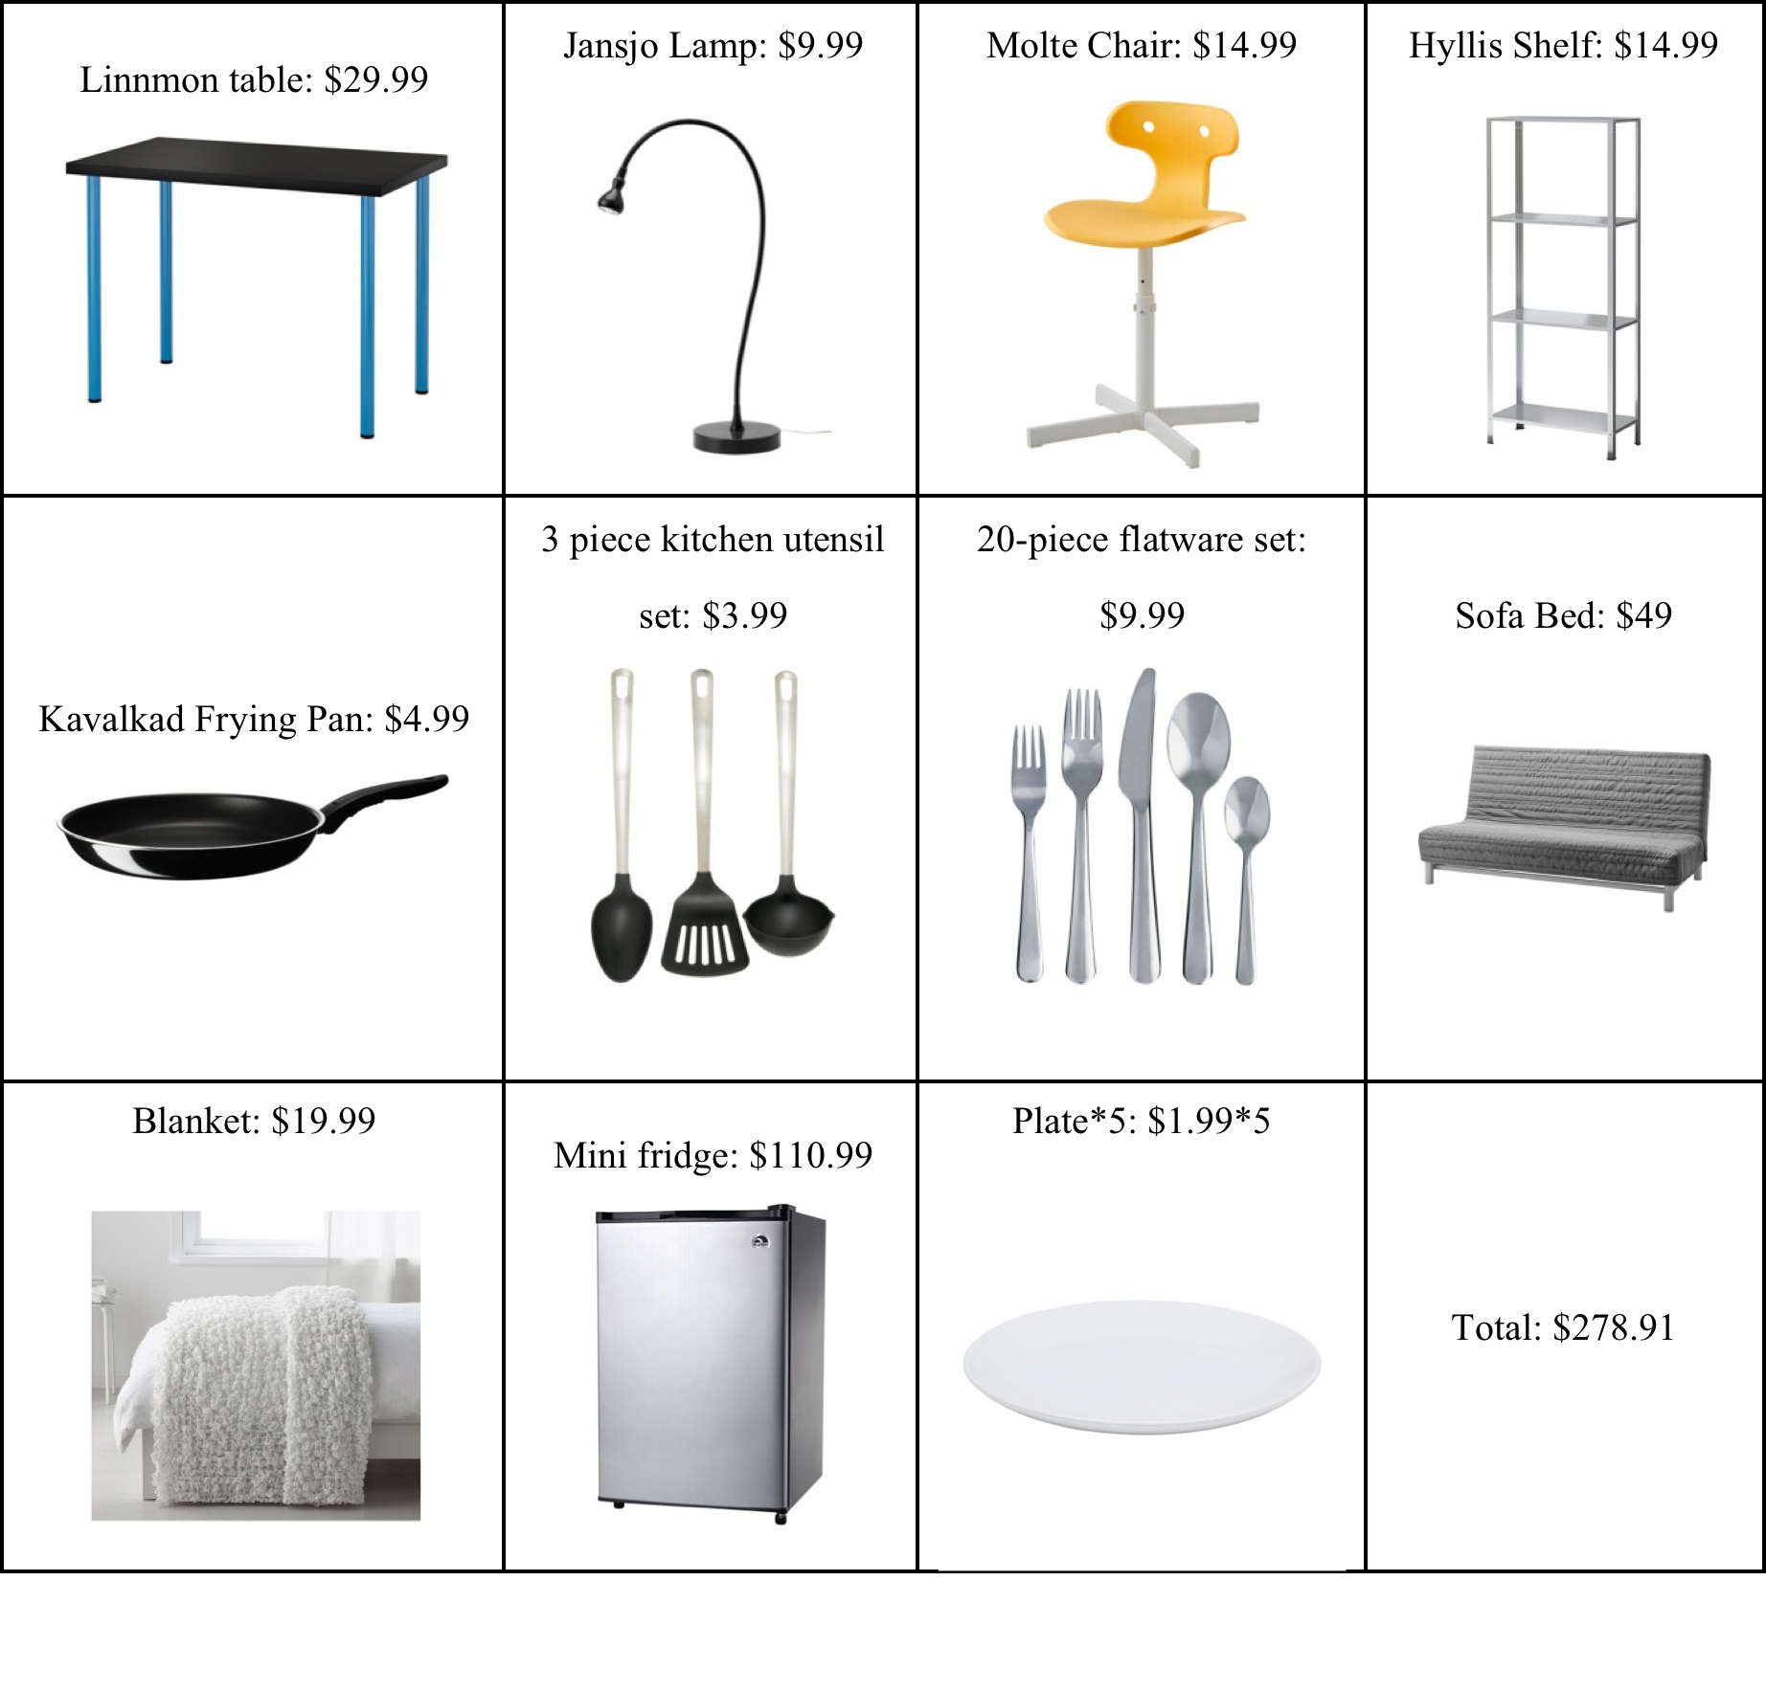

Slide 7
TRANSPORTATION
Rely on public transportation
Public Transportation Options: subway and bus
Use this website to figure out subway and bus stops: http://www.mta.info/nyct
30-Day Unlimited Ride MetroCard Cost: $116.50

Slide 8

PERSONAL EXPENSES
Cell phone: $50/month with AT&T
Internet: Max Turbo $25/month with AT&T
Groceries: $150 /month at FreshDirect
Hair products: $100 /month

Slide 9
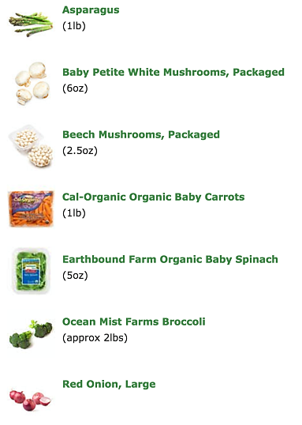
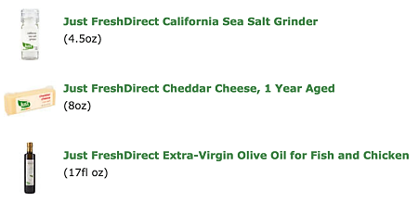
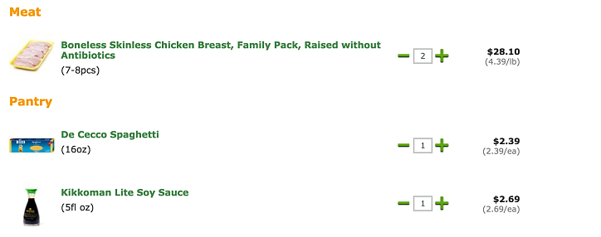


PERSONAL EXPENSES - GROCERIES

Slide 10

HEALTHCARE
Plan #2
Private employees (i.e., you work for a private company or business)
9% of your salary must be deducted for health insurance ($3600)
$3,000 deductible - you must budget for this
$20 copayments for Dr. visits and prescription drugs

Slide 11

DONATIONS
Stand For Trees
Kariba African Wildlife Corridor $20
Amazon Forest Protection Project $20
Congo Basin Rainforest Project $10
Valparaiso Amazon Conservation and Community Project $10
Total: $60

Slide 12
BUDGET
 | Monthly Income | Annual Income
Gross Income | 40000 | 480000
Personal Expenses | Monthly Expenditure | Annual Expenditure
Rent | 2200 | 26400
Utilities | 62.61 | 751.32
Furnishings | 278.91 | 3346.92
Car Payment | 0 | 0
Car Insurance | 0 | 0
Public Transportation | 116.5 | 1398
Land Line Phone | 0 | 0
Cell Phone | 50 | 600
Internet | 25 | 300
Cable TV | 0 | 0
Entertainment | 0 | 0
Regular Copay's | 20 | 240
Other Personal Expenses (Total) | 100 | 1200
Health Insurance | 6620 | 79440
Donations (Total) | 60 | 720
Retirement Investments |  | 0
Student Loan | 0 | 0
Groceries | 150 | 1800
Gas/Car Repairs | 0 | 0
Deposits | 4000 | 48000
Taxes/S.S. | 17973 | 215676
Miscellaneous One Times Expenses | 0
Net Income | 8343.98 | 100127.76

Slide 13
CITATIONS
https://targetjobs.co.uk/careers-advice/job-descriptions/279895-investment-analyst-job-description
http://www.ehow.com/about_6624456_stock-analyst-job-description.html
http://www.investopedia.com/articles/financialcareers/06/financialanalyst.asp
http://www.payscale.com/research/CA/Job=Investment_Analyst/Salary
http://www.point2homes.com/US/Neighborhood/NY/New-York-City-Demographics.html#
http://www.zillow.com/homedetails/56-Pine-St-APT-6E-New-York-NY-10005/69509766_zpid/
http://www.csgnetwork.com/elecenergycalcs.html
http://www.ikea.com/us/en/
http://www.mta.info/nyct
http://www.verizonwireless.com/landingpages/verizon-plan/?cmp=KNC-C-HQ-NON-R-AC-NONE-NONE-2K0PX0-PX-GAW-71700000010306107&gclid=CMmUk6vu8ssCFZNlvAodix8HYQ&gclsrc=ds
https://www.att.com/shop/wireless/data-plans.html?&WT.srch=1&source=ECPS0000000PSM00P
https://www.freshdirect.com/expressco/view_cart.jsp
https://standfortrees.org/en/#protectaforest

